Slide 1
Data Science in Healthcare
Presented By:
Harshitha Konduru
Kaushik Mantha
Lalith Sai Reddy Kaamala
Preethu Nath Manjunath
Saketh Saridena
Vineel Rayapati

Slide 2

Revolutionizing Healthcare
In recent years, data science has emerged as a powerful tool in transforming various industries, and one field that has greatly benefited from its applications is healthcare.
With the abundance of patient data, technological advancements, and the growing need for personalized medicine, data science has become instrumental in improving healthcare outcomes, optimizing processes, and enabling evidence-based decision-making

Slide 3
Applications of Data Science in
healthcare
Public health impact
Health Monitoring and Wearable Devices
Drug Discovery and Development
Abundance of Patient Data
Precision Medicine and Personalized Treatments
Genomic Analysis
Early Detection and Diagnosis
Clinical Decision Support Systems
Medical Imaging

Slide 4

Companies & Research Groups in Healthcare Data Science
Mayo Clinic: Research & Patient Care
Cerner Corporation: EHR & Workflow Optimization
Roche: Drug Development & Precision Medicine
Google Health: Medical Imaging & EHR Tools
Owkin: Federated Learning for Research

Slide 5
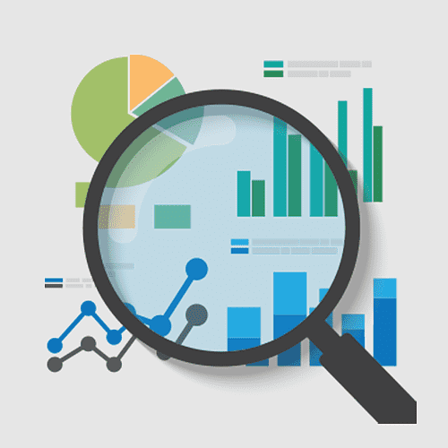
Key Skills for Healthcare Data Scientists
Statistical Analysis
Programming (Python/R)
Data Cleaning & Preprocessing
Machine Learning & AI
Healthcare Domain Knowledge
EHR Systems
Privacy & Security
Data Visualization
Big Data Technologies
Experimental Design
Communication Skills

Slide 6
Relevant Elective COURSES AT CU Boulder
CSCI 5822: Probabilistic Models of Human and Machine Learning
CSCI 5922: Neural Networks & Deep Learning
IPHY 5262: Bioinformatics and Genomics
MSBX 5310: Customer Analytics
STAT 5600: Statistical Learning
STAT 5680: Collaboration for Data Scientists

Slide 7
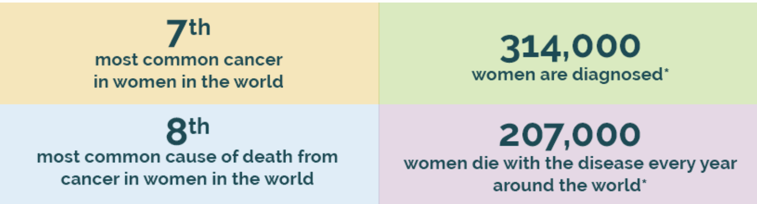
OVARIAN CANCER STATISTICS

Slide 8

Understanding Cancer Patient Data for Survival Analysis
Data Source: https://gdc.cancer.gov/about-data/publications/ov_2011
Objective: To understand the impact of various factors of cancer patient survival and disease progression
Key Columns
Statement of Question of Interest

Slide 9
S T E P S
Data Collection
Exploratory Data Analysis and Visualization
Recommendations and Conclusion
Data Exploration
Data Cleaning and Pre-Processing

Slide 10
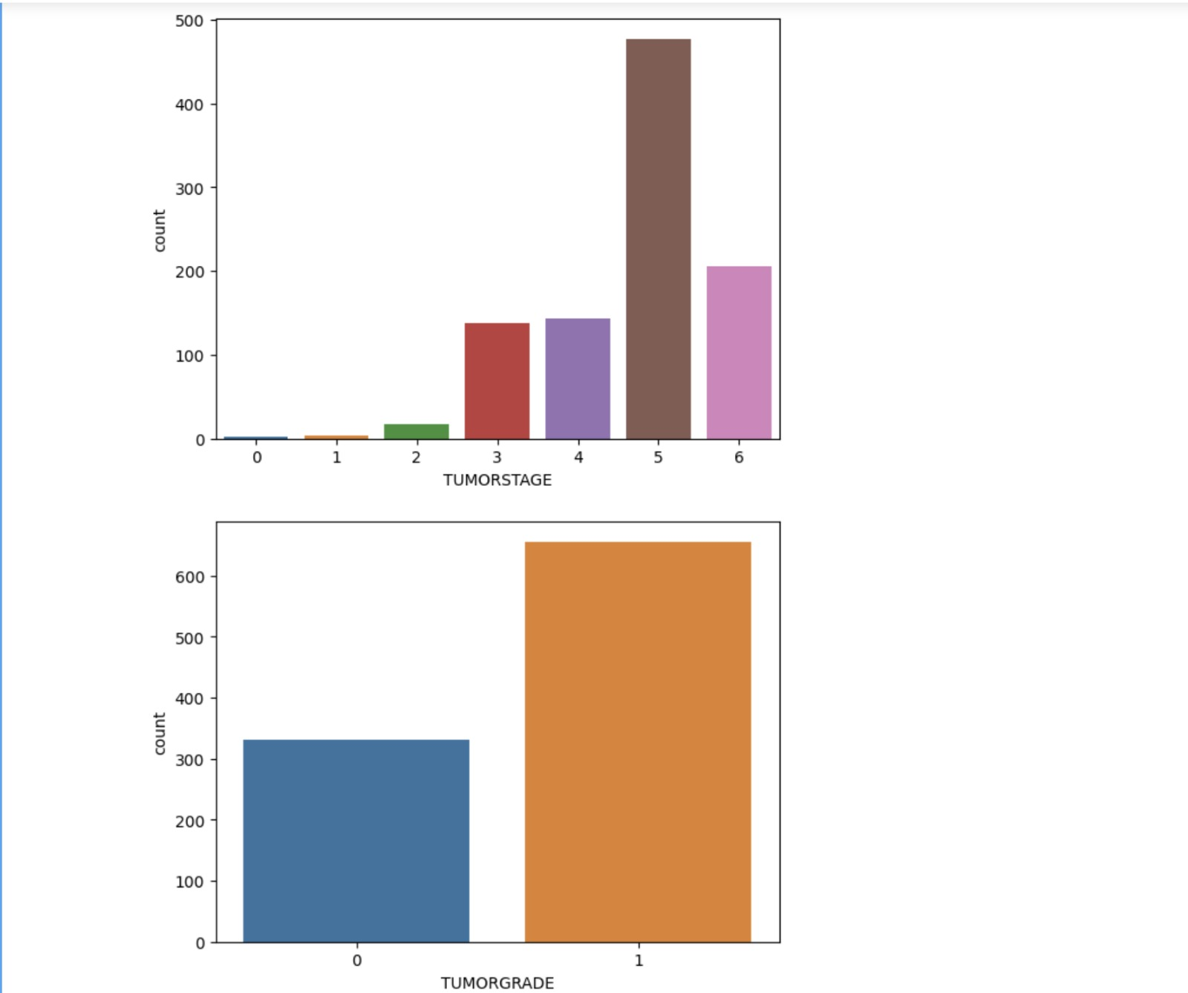
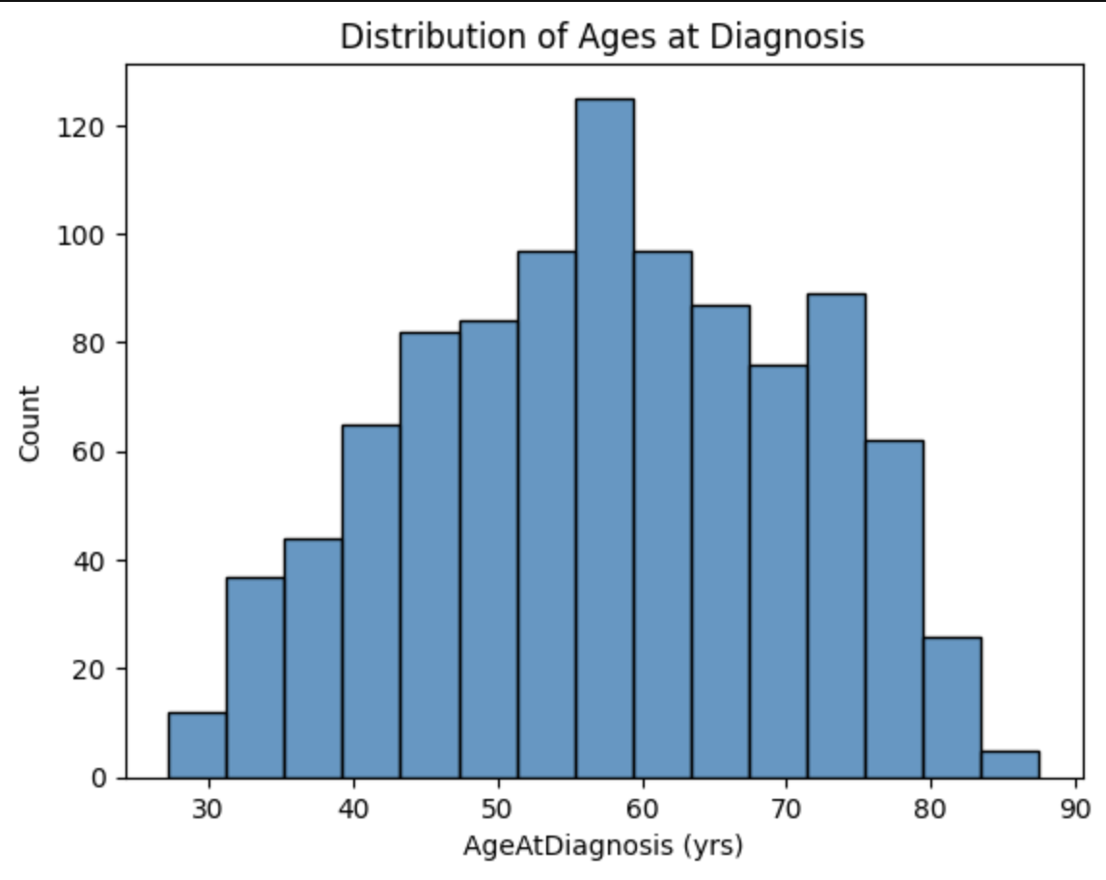
VISUALIZATIONS

Slide 11
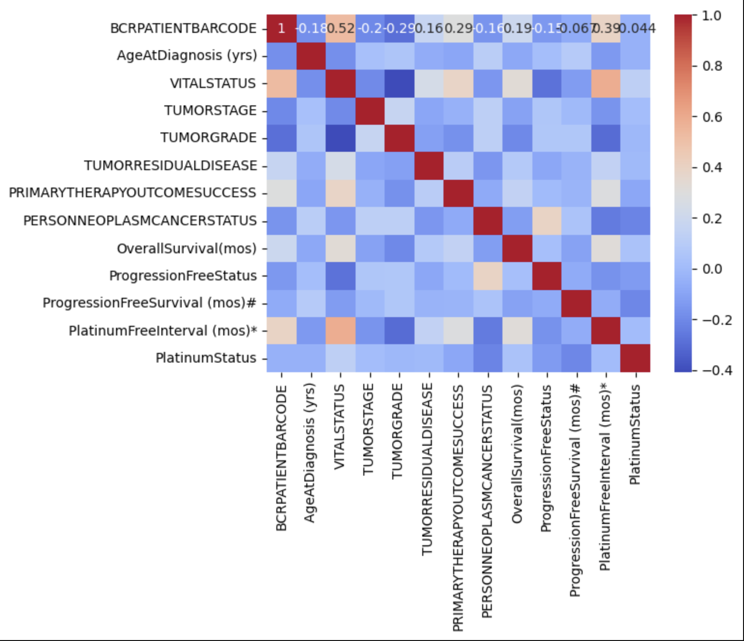
CORRELATION MATRIX

Slide 12
CONCLUSION AND AREAS OF IMPROVEMENT
Emerged as a significant Catalyst in healthcare
Real-time Data Analytics
Standardized data frame works for data governance
Patient centered treatment plans and Design

Slide 13
THANK YOU

